Slide 2
Objectives
Explain why computer literacy is vital to success in today’s world
Differentiate among various computer-related majors for college students
List the general areas of Information Technology
Appreciate the capabilities of computing

Slide 3
Outline
What is Computing?
Fields of Discipline
Computing Domains
Knowledge Areas in Computing

Slide 4
What is Computing
Computing refers to any goal-oriented activity requiring, benefiting from, or creating computers
Source: Computing Curricula 2005 The Overview Report by ACM & IEEE

Slide 5
What is Computing
Computing includes designing and building hardware and software systems for a wide range of purposes
  Processing, structuring, and managing various kinds of information.
  Doing scientific studies using computers
  Making computer systems behave intelligently
  Creating and using communications and entertainment media

Slide 6
Fields of Disciplines
Computer Engineering
Information System
Information Technology
Software Engineering
Computer Science
Source : Association for Computing Machinery (ACM)

Slide 7
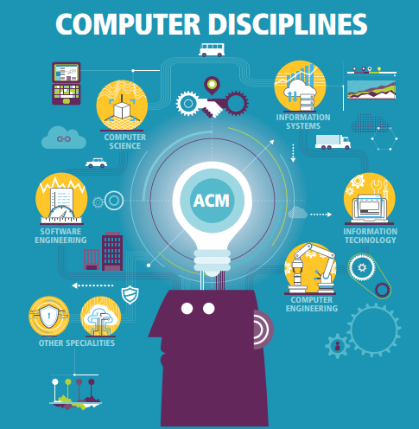
The ACM (Association of Computing Machinery) has identified five different computing disciplines.

Slide 8
FIELDS OF DISCIPLINE IN COMPUTING CHARACTERISTICS AND DIFFERENCES
Computer Engineering
Typically involves software and hardware and the development of systems that involve software, hardware, and communications. Concerned with the design and construction of computer and computer based system.
Computer Science
Currently the most popular of the computing disciplines; tends to be relatively broad and with an emphasis on the underlying science aspects. Covers the widest range of computing topics from its theoretical foundations to the development of new computing technologies and techniques.
Information Systems
Essentially, this is computing in an organizational context, typically in businesses. Is focused on integrating information technology solutions and business process.

Slide 9
FIELDS OF DISCIPLINE IN COMPUTING CHARACTERISTICS AND DIFFERENCES
Information Technology
Focuses on computing infrastructure and needs of individual users; tends to involve a study of systems (perhaps just software systems, but perhaps also systems in support of learning, of information dissemination, etc.). Programs prepare students to meet the computer technology needs of business and other organizations.
Software Engineering
Focuses on large-scale software systems; employs certain ideas from the world of engineering in building reliable software systems. Is the discipline of developing and maintaining large software systems.

Slide 10
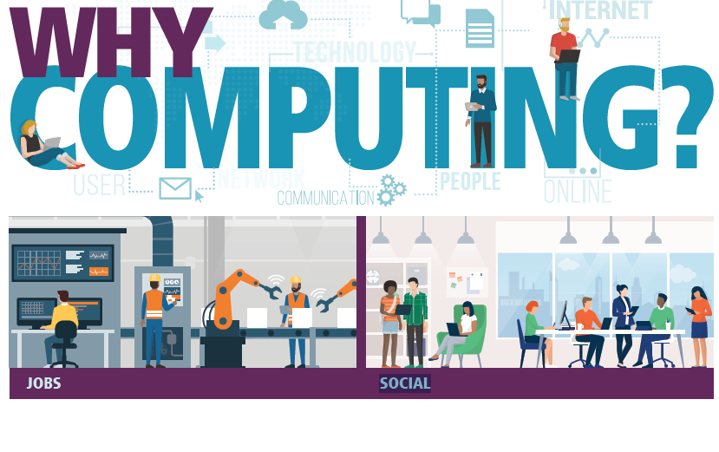
The job market for computing graduates is very strong, and according to government, estimates, demand will continue to be high well into the future.
Contrary to stereotypes, computing work is often highly social, involving frequent interaction with others and rewarding communication and social skills.

Slide 11


Demand for computing exists world-wide. A career in computing offers unparalleled mobility, allowing you to work abroad or work while travelling.
The world of computing work can be full of innovation and creativity. The world of tomorrow is being created by computing graduates today.

Slide 12


Computing work supports flexible lifestyles. You can work full-time in an office, part-time as a parent at home, or take advantage of world-wide demand for short-term computing contracts.
Computing work is extremely varied, from development, to design, to management. This means less chance of boredom, as your work often changes measurably from year to year.

Slide 13
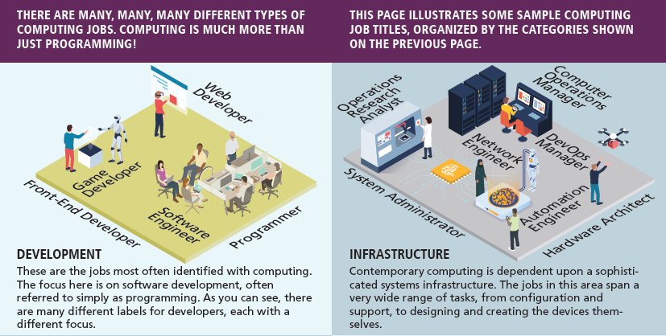

Slide 14
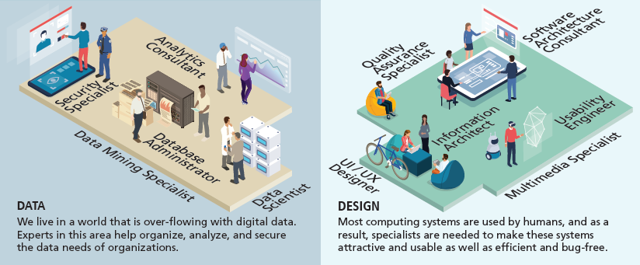

Slide 15
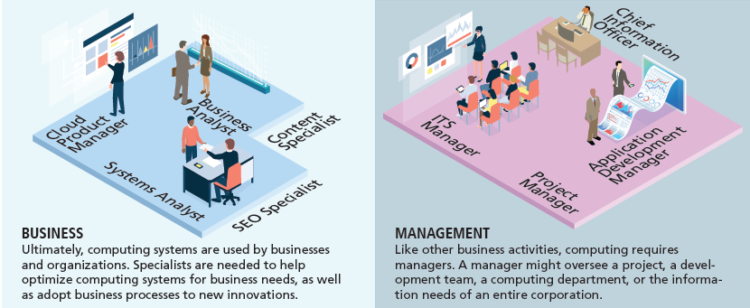

Slide 16
Computing
Domains
Algorithm
Computer Theory
Cryptography
Distributed Computing
Cloud Computing
Machine Learning / Computational Learning
Big Data
Computer Vision
Neural Network
Platform Technologies
Cybersecurity
User Interface Design
These are specific, specialized discipline or field in computing.

Slide 17
Computing Domains
Algorithms
  Algorithms are an explicitly described method for solving a problem.
Computer Theory
  is the branch of computer science concerned with finding out how efficiently a given problem can be solved on a model computer using a given algorithm.

Slide 18
Computing Domains
Cryptography
  Cryptography is an ancient science concerned with secret writing.
  In the modern context of computers, cryptography is the science of encrypting data.
Big Data
  It is the collection and analysis of large amounts of data. It is usually associated with large Internet companies such as Facebook and Google.

Slide 19
Computing Domains
Distributed Computing
  Distributed computing is a means of breaking up a complex problem, distributing the pieces to various computers across a network (usually the Internet), and having them work on the problem concurrently until the problem is solved.
Platform Technologies
  A Platform is a group of technologies that are used as a base upon which other applications, processes, or technologies are developed.

Slide 20
Computing Domains
Cloud Computing
  According to Dikaiakos et. Al [2009] and others, “Cloud computing is a recent trend in IT that moves computing and data away from desktop and portable PCs into large data centers”
  It refers to applications delivered as services over the Internet as well as to the actual cloud infrastructure — namely, the hardware and systems software in data centers that provide these services

Slide 21
Computing Domains
Computational Learning / Machine Learning
  Computational learning, more commonly referred to as machine learning is a sub-field of artificial intelligence.
  It is dedicated to the design and development of algorithms and techniques that allow computers to ‘learn’.
Cybersecurity
  Cybersecurity is the practice of protecting systems, networks, and programs from digital attacks.

Slide 22
Computing Domains
Computer Vision
  Computer vision is the field of computer science in which the goal is to process video or still images and produce from them a representation of the world. This entails things such as recognition of objects, gestures, and motion.
User Interface Design
  User Interface (UI) Design is the process of making interfaces in software or computerized devices with a focus on looks or style

Slide 23
Computing Domains
Neural Networks
  Neural networks are artificial intelligence agents that simulate biological neuron structures to process inputs and produce outputs. Neural networks are trained on inputs until they recognize patterns and produce useful outputs.

Slide 24
Knowledge Area
Information System
Implement Information system
Information Management (Database)
Design a database mgt system
Train Users to use Information Systems
Maintain and Modify Information Systems
Model and design a database
Select database products
Configure Database products
Manage databases
Train and support database users
Implement information retrieval software

Slide 25
Knowledge Area
Networking and communications
Design network configuration
Select network components
Install Computer Network
Manage Computer Networks
Implement Communication software
Manage communication resources
Implement mobile computing system
Manage mobile computing resource
Intelligent System
Design auto reasoning system
Implement Intelligent System

Slide 26
Knowledge Area
Develop corporate information plan
Develop computer resource plan
Schedule/budget resource upgrade
Install / upgrade computers
Install Upgrade Software
System Development through Integration
Manage an organization’s presence
Configure & integrate e-commerce software
Develop multimedia solutions
Configure & integrate e-learning systems
IT resource planning

Slide 27
REFERENCES
Website:
Fungsi Motherboard Processor Memori Dan Harddisk | Computer hardware, Computer hardware store, Computer Pinterest. https://www.pinterest.ph/pin/88594317657692933/?mt=login
Unit 4 - Hardware & Ergo - Davids BTA30 Portfolio 2016 Sites.google.com. https://sites.google.com/site/davidsbtaportfolio/unit-4---hardware-ergo.
Computer Software Icon #229946 - Free Icons Library. Icon-library.com. https://icon-library.com/icon/computer-software-icon-14.html
https://www.programiz.com/cpp-programming
https://www.rapidtables.com/code/text/ascii-table.html
Timeline of Computing History: https://www.computer.org/cms/Computer.org/Publications/timeline.pdf

Slide 28
REFERENCES
Books:
Computing Essentials 2017 Complete, Timothy O‟Leary & Linda O‟Leary
Discovering Computers Fundamentals 4th Edition, 2008
Gary B. Shelley, Thomas J. Cashman, Misty E. Vermaat
Understanding Computers: Today and Tomorrow Comprehensive 15th Edition Deborah Morley, Charles S. Parker
Computing Curricula 2005 The Overview Report by ACM & IEEE
Information Technology Curricula 2017 by ACM & IEEE-CS
Computer Science Curricula 2013 by ACM & IEEE-CS
10 Domains in Computer Science, Kyle Harrity (September 1, 2013)

Slide 29
--- END ---

